Slide 1
Notes:
This is the first level bullet for notes 12 point Arial Regular
This is the second level bullet for notes 9 point Arial Regular
This is the third level bullet for notes 9 point Arial Regular

Slide 2
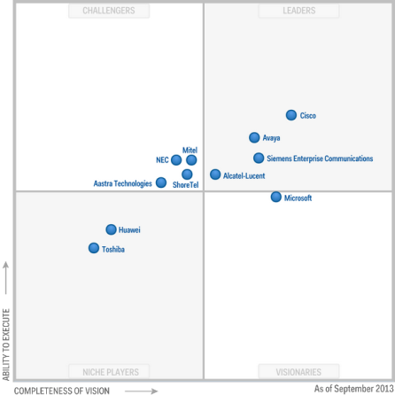
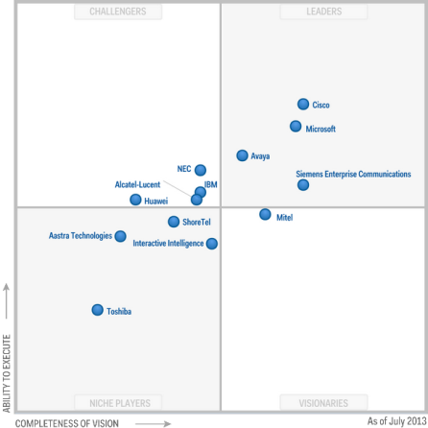
Gartner Reports
MQ for
Corporate Telephony
MQ for
Unified Communications

Slide 3
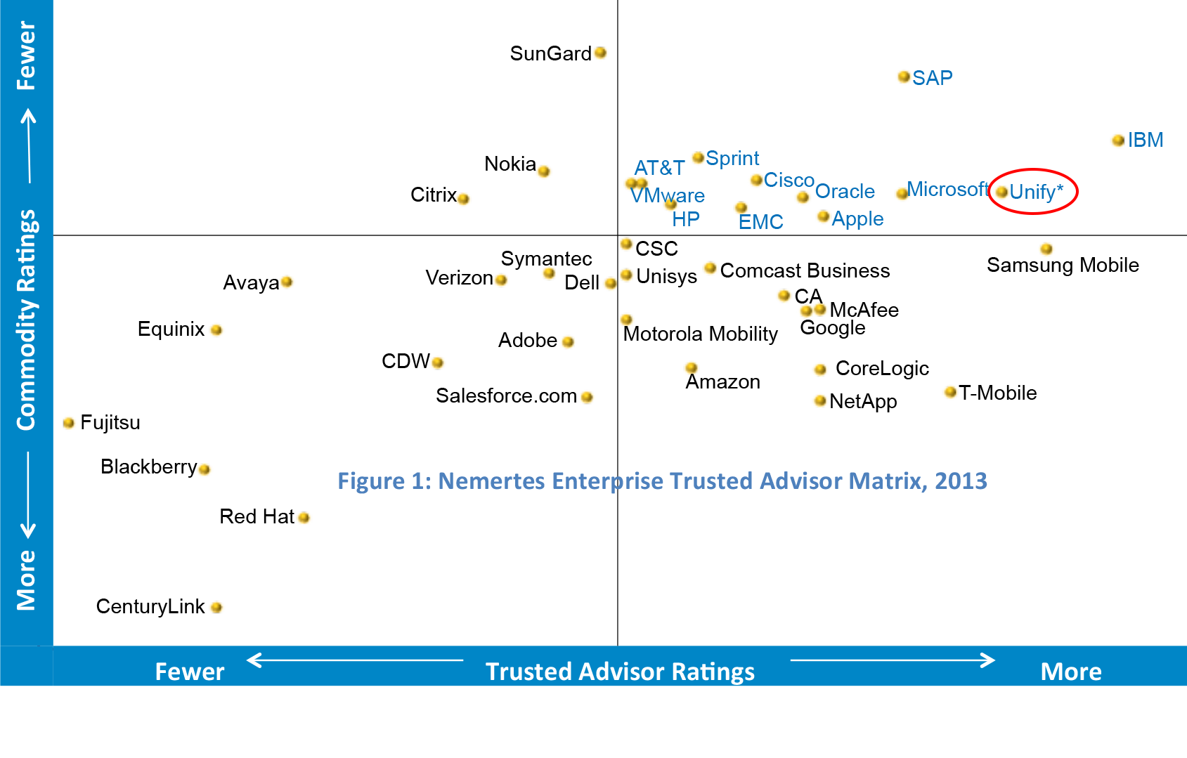
Nemertes Research
Unify named as a top three finisher in 2013 Enterprise Trusted Advisor annual report.

Slide 4
Frost & Sullivan
2013 EMEA; Product Line Strategy Award - Hosted Contact Center

